Slide 1
Pfizer Vaccine Tweets: A Sentiment Analysis
Justin Ehly, Nicole Norelli, and Mingyang Nick YU

Slide 2
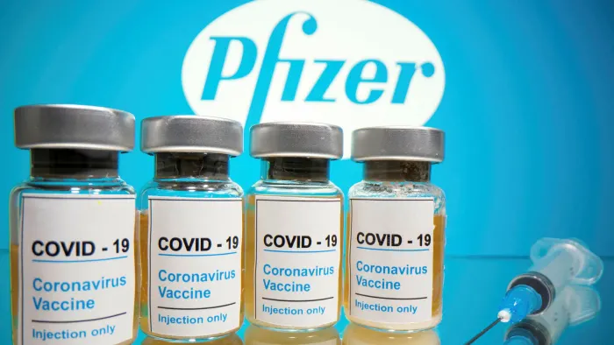
Contents
Project Overview/ Abstract
Data Description
Sentiment Analysis
Data Analysis
Conclusions
Limitations and Future Directions

Slide 3
Project Overview
Sentiment Analysis of Tweets using
#PfizerBioNTech hashtag
Location Information
Date Range: December 12, 2020 – March 13, 2021
Dataset – Kaggle/ CDC/ US Census
Data Cleaning/ EDA - R
Sentiment Analysis: Amazon S3 + Amazon Comprehend NLP
Data Visualization/ Conclusions - R

Slide 4
Procedure
Data Step
Date Collection
NLP Sentiment
Amazon Comprehend Analysis
Conclusions
Visualizations
Clean
EDA
Twitter (Kaggle)
CDC
US Census
AWS S3
Conclusions
Notes:
List all of the steps used in completing your experiment.
Remember to number your steps.

Slide 5
Data
16 variables
(examples) user_name, user_location, user_followers, date, text (tweet), hastags, retweets (num)
6,821 tweets total
12/12/20 – 1/20/21 – 4,139 tweets
1/21/21-3/13/21 – 2,682 tweets
Missing Data: user_description (427), user_location (1381), hastags (1676)
Geographic Variables:

Slide 6
Sentiment Analysis
…using cleaned data
S3 (upload/ download)
Amazon Comprehend: Natural Language Processing to determine emotional sentiment
Pos + Neg + Neu + Mixed = 1
Each tweet is considered its own document (charge/ document)
Recombine Sentiment with original EDA data

Slide 7
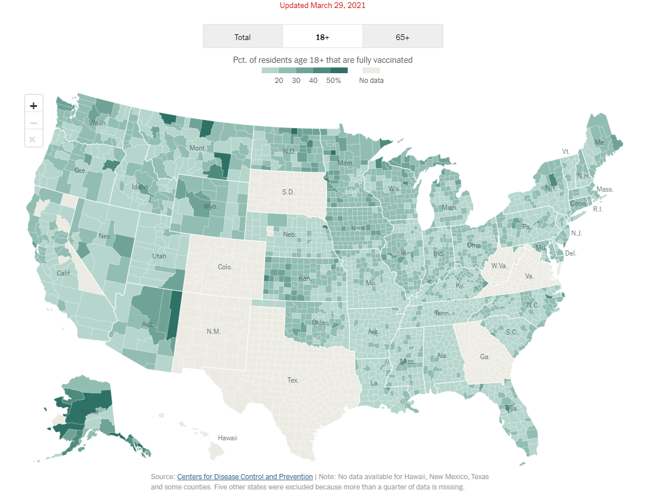
Data Analysis: Geographic Trends
Tweet by Location
Country
State
City
Notes:
Self reported, lots of missing data, imputed where possible
Only ran on initial dataset due to complexities converting user generated data to usable data
Image Source: https://www.nytimes.com/interactive/2020/us/covid-19-vaccine-doses.html

Slide 8
By Country
Countries with No Pos Sent: Cyprus, Denmark, Japan, Niger, Philippines, Qatar, Tur-key, and Venezuela (each between 11-43 tweets)
Highest Proportion Pos Sent: Ireland
Lowest Proportion Pos Sent: India
Smallest Proportion Neg Sent: UAE
No larger pattern Sentiment : Country

Slide 9
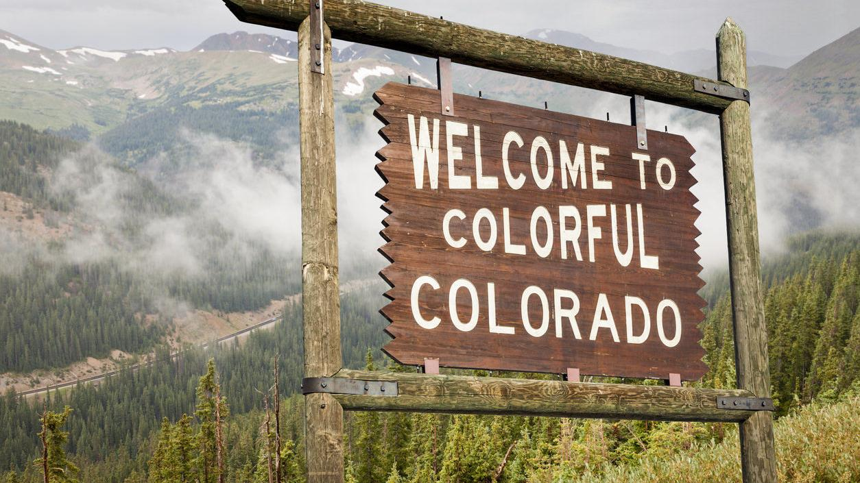
By State
953 tweets identified by state.
States 10+ Tweets:
Highest Pos Sent: CO
variety of users, may medical prof.
No Pos Sent: Vermont
most tweets from a single user
Did not find any meaningful relationship between Covid-19 cases and state Sentiment when analyzed on a daily basis
Image Source: https://www.outtherecolorado.com/features/8-reasons-no-one-should-want-to-move-to-colorado/article_9a81ccb2-7475-5e2d-bb79-187899ff3d5f.html

Slide 10
By US Census Region
Grouped by 4 regions
Midwest
North East
South
West
Slightly higher Positive Sentiment in Midwest than West

Slide 11
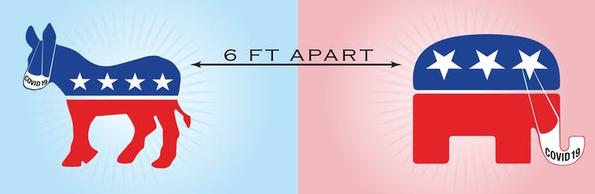
By Political Party
Democrats skew slightly more Negative
Republicans skew slightly more Positive
Image Source: https://theconversation.com/coronavirus-new-survey-shows-how-republicans-and-democrats-are-responding-differently-138394

Slide 12
Sentiment Over Time
Increase in Positive Sentiment
Decrease in Negative Sentiment
Decrease in Neutral Sentiment

Slide 13
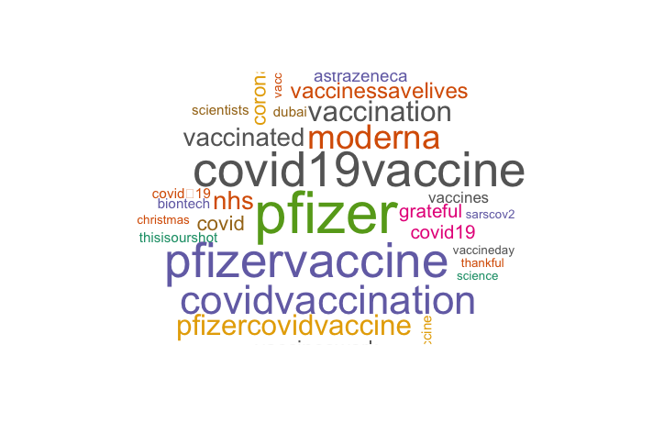
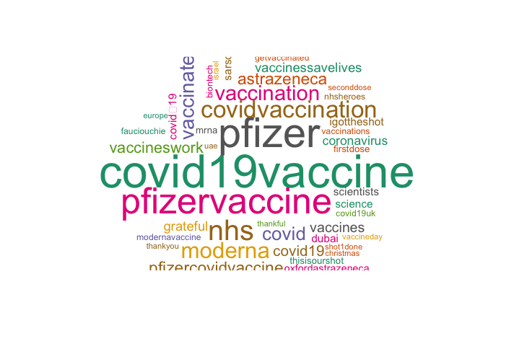
#PositiveComparison
01-21-21
03-15-21

Slide 14
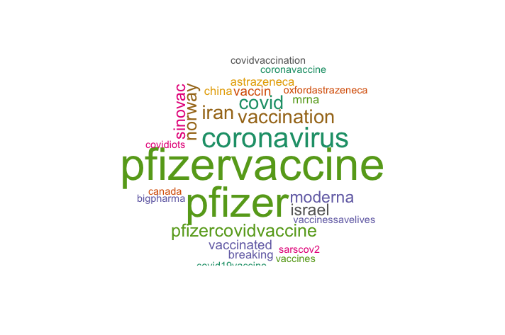
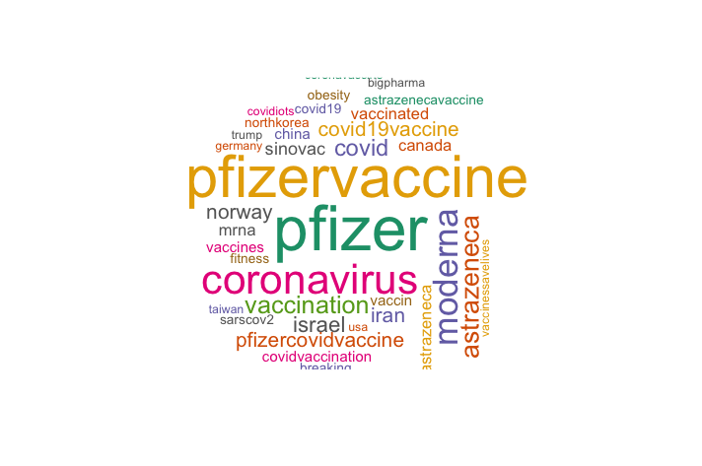
#NegativeComparison
01-21-21
03-15-21

Slide 15
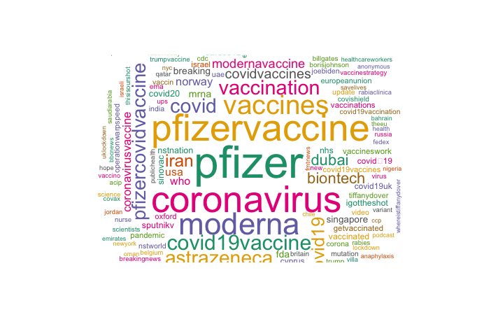
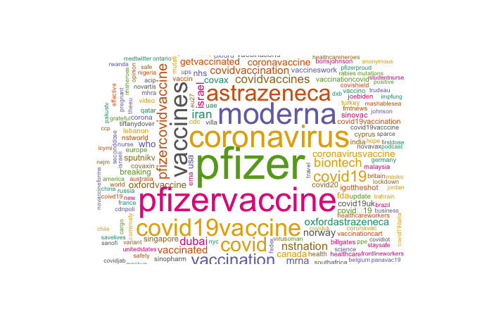
#NeutralComparison
01-21-21
03-15-21

Slide 16
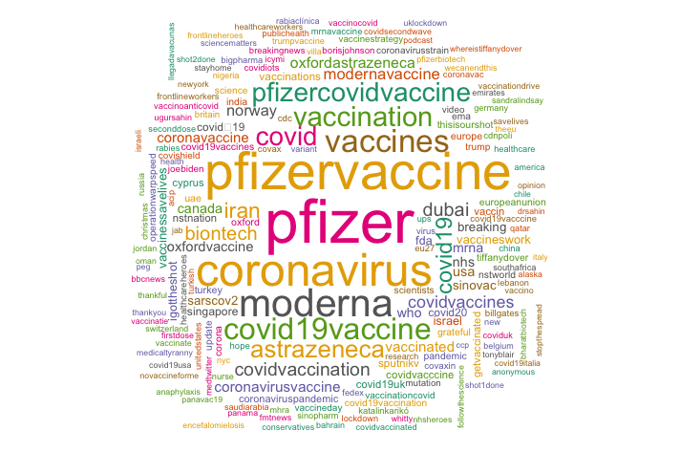
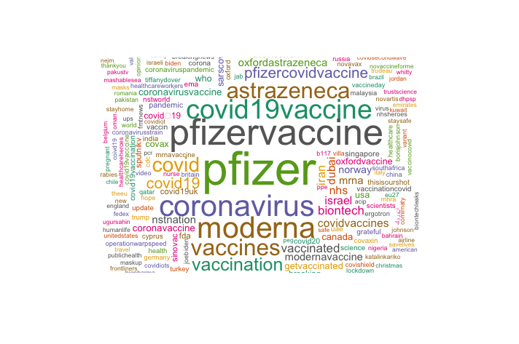
#OverallComparison
01-21-21
03-15-21

Slide 17
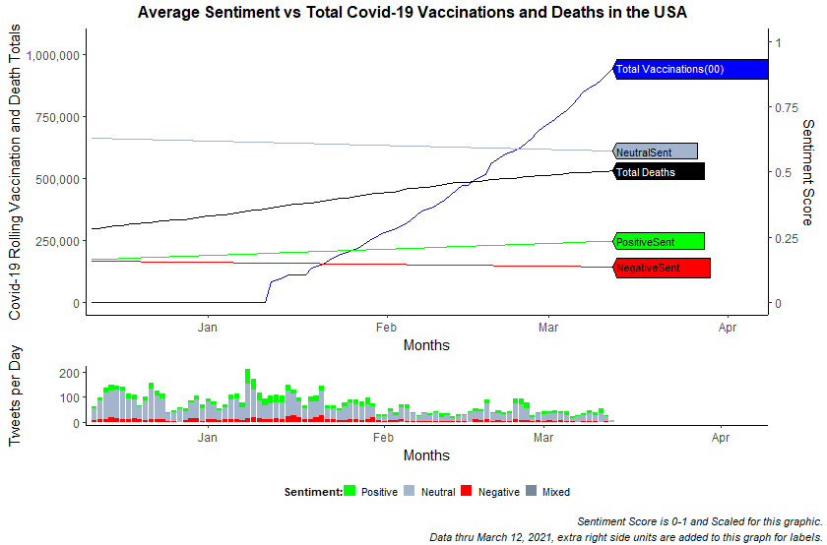
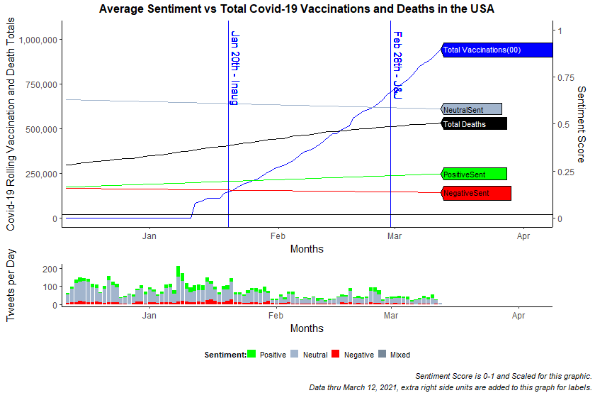
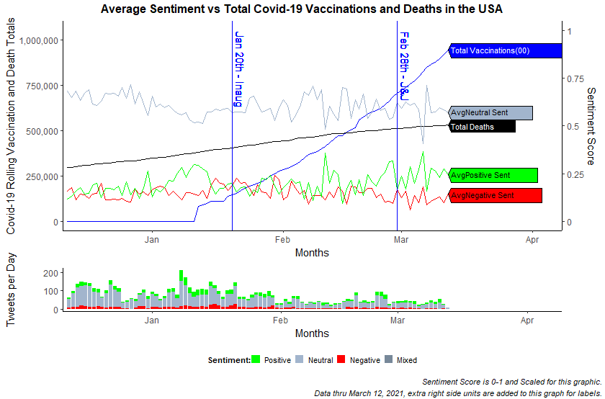
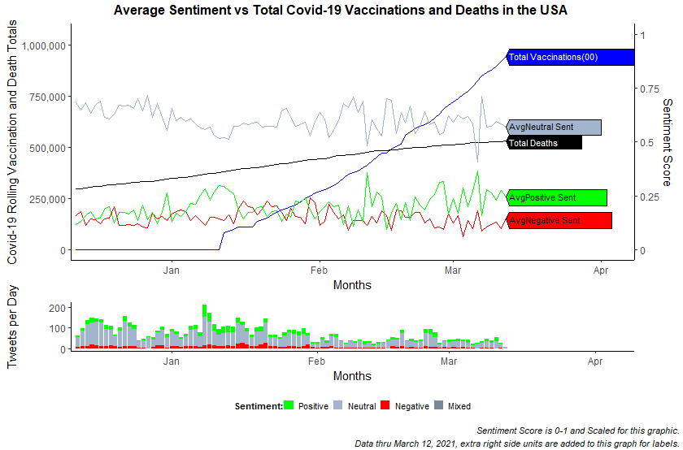
Conclusion
Increase in Positive Sentiment over time
Decrease in Neutral and Negative Sentiment over time
Decrease in volume of Tweets
Waning public interest
Increase of vaccine availability
Change in governmental messaging

Slide 18

Limitations & Future Directions
Self-reporting across Twitter limits location reporting
Expand analysis to real-time framework
Expand #hashtags to be more inclusive of all Covid-19 Vaccination Variants
Expand to include additional languages
Image Source: https://blogs.microsoft.com/blog/2020/12/11/successful-covid-19-vaccine-delivery-requires-strong-tech-partnerships/

Slide 19
Works Cited
Loomba, S., de Figueiredo, A., Piatek, S.J. et al. Measuring the impact of COVID-19 vaccine misinformation on vaccination intent in the UK and USA. Nat Hum Behav (2021). https://doi.org/10.1038/s41562-021-01056-1W
de Figueiredo, A., Simas, C., Karafillakis, E., Paterson, P. & Larson, H. J. Mapping global trends in vaccine confidence and investigating barriers to vaccine uptake: a large-scale retrospective temporal modelling study. Lancet 396, 898–908 (2020).
Kim, H. K., Ahn, J., Atkinson, L. & Kahlor, L. A. Effects of COVID-19misinformation on information seeking, avoidance, and processing: a multicountry comparative study. Sci Commun 42, https://doi. org/10.1177/1075547020959670 (2020).
Schmidt, A. L., Zollo, F., Scala, A., Betsch, C. & Quattrociocchi, W. Polarization of the vaccination debate on Facebook. Vaccine 36, 3606–3612 (2018).
KFF Health Tracking Poll/ KFF COVID-19 Vaccine Monitor (February 15-23, 2021)

